Slide 1

Visualizing Model Optimization for Orbital Debris Characterization
Marina M. Dunn
Computing/CASC
Dr. Benjamin Priest

Slide 2
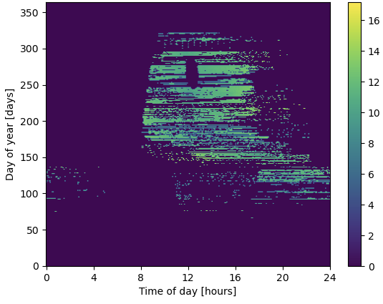
Debris Characterization
Goal: Observe and characterize orbital debris
Importance: Space Situational Awareness
Approach:
Compare observations to historical catalog of known satellites
Determine physical characteristics
Challenges:
Gaps in observations (i.e. weather)
Proposed Solution:
Fill in gaps using predictive modeling
Make tool to visualize and adjust model parameters
Real Observations Missing Data
Fill in gap
~50 days
~2 hours
Source: Imene Goumiri

Slide 3
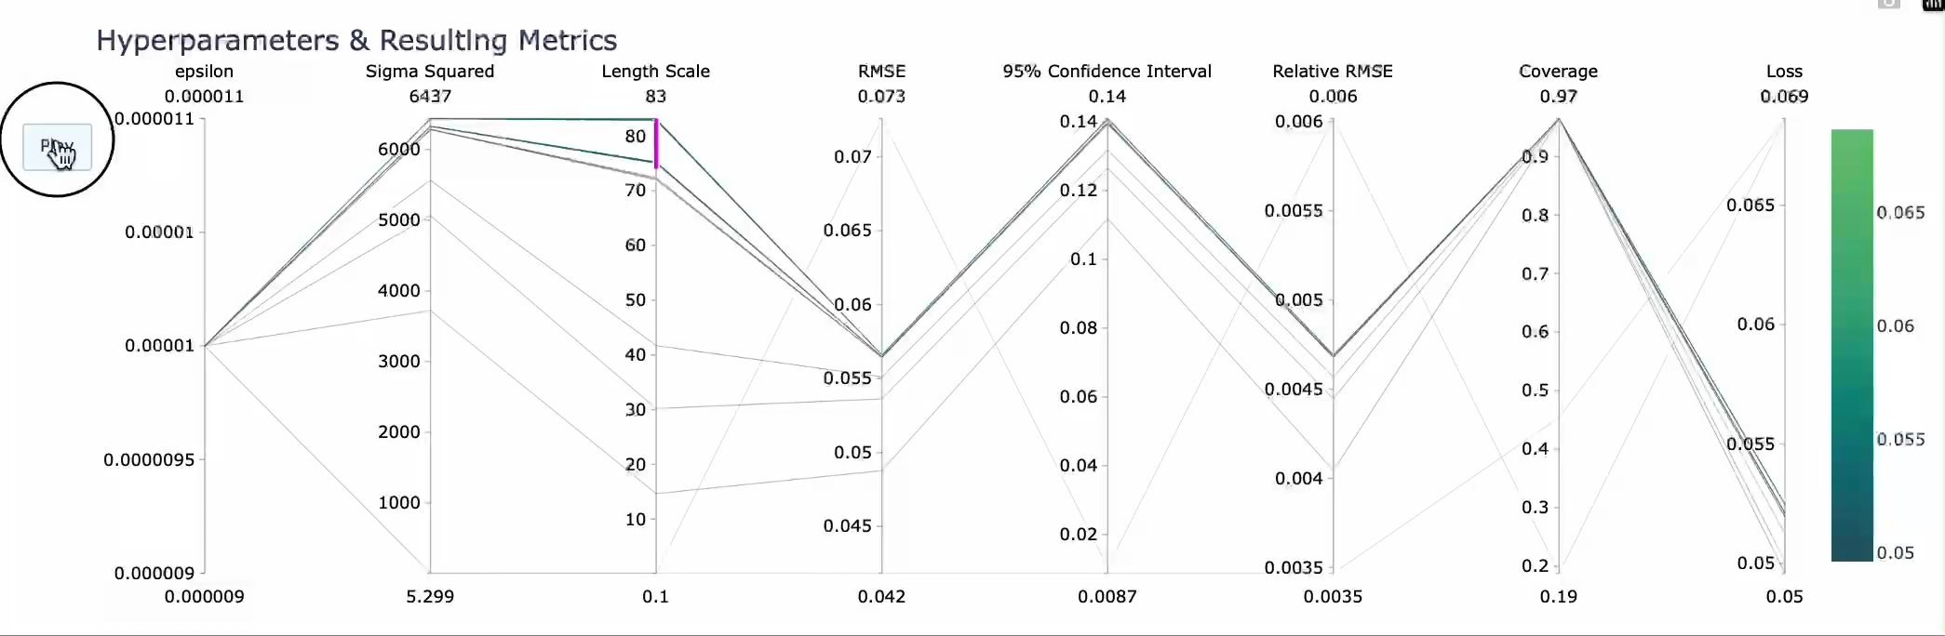
Visualizing Model Optimization
Interactively view parameters and performance metrics!

Slide 4
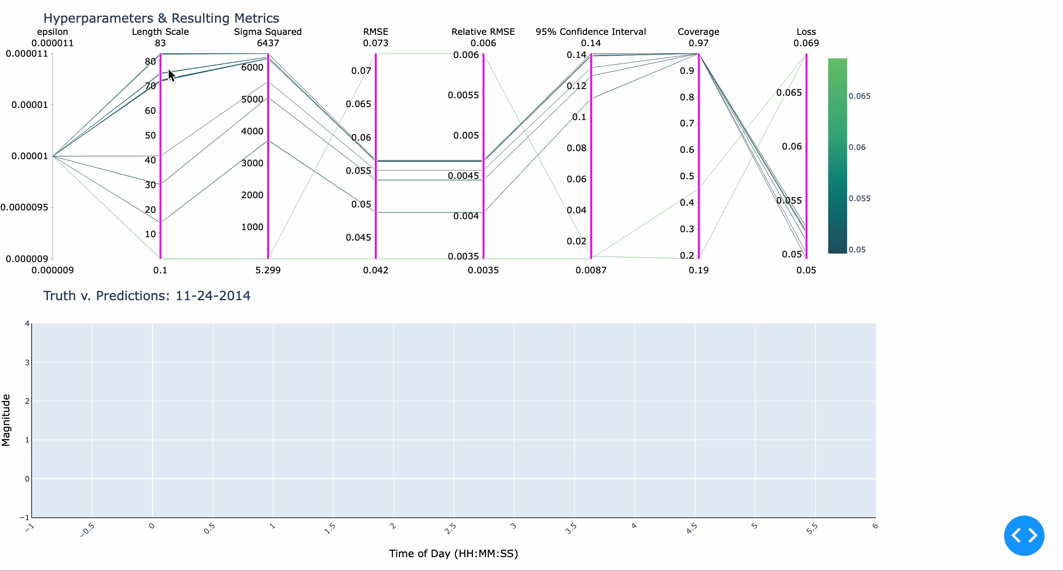
Customization & Next Steps
Produce plots
of interest
based on
selections!
Future Goals: Dynamic optimization and use for astronomical surveys (i.e. LSST)

Slide 5
Disclaimer
This document was prepared as an account of work sponsored by an agency of the United States government. Neither the United States government nor Lawrence Livermore National Security, LLC, nor any of their employees makes any warranty, expressed or implied, or assumes any legal liability or responsibility for the accuracy, completeness, or usefulness of any information, apparatus, product, or process disclosed, or represents that its use would not infringe privately owned rights. Reference herein to any specific commercial product, process, or service by trade name, trademark, manufacturer, or otherwise does not necessarily constitute or imply its endorsement, recommendation, or favoring by the United States government or Lawrence Livermore National Security, LLC. The views and opinions of authors expressed herein do not necessarily state or reflect those of the United States government or Lawrence Livermore National Security, LLC, and shall not be used for advertising or product endorsement purposes.

